Slide 1
IPL Match Scheduling
Vamsi Krishna Pirati
Rajesh Avunoori
Kushwanth Boina

Slide 2
PROBLEM STATEMENT
We need to optimize IPL 2024 schedule so that travel and accommodation cost is minimized.
Optimizing schedule involves making decisions about:
Which airline partner and hotel partner to pick match.
Considering total time span of tournament and rest days of teams.

Slide 3
ASSUMPTIONS
Players will arrive at the venue by flight on the day before the match and will take one day rest after match day and flight will be next or next to next day after the rest day.
Hotel rooms will be booked for minimum 3 nights and may increase to maximum of 4 nights
The price of flights and hotels will be dynamic based on days but will remain static for entire day.
Assuming the airline partner and hotel partner are available in all the cities.
Weather has no effect on schedule of matches.

Slide 4
DECISION VARIABLES
Let Yt,i,j,a,d : binary variable for team(t) Travels from venue(i) to venue(j) using airline ‘a’ on day ‘d’
Let Xt,v,d represents that team(t) Plays on venue(v) on day(d)
Let Ci,j,a,d represent the Flight Cost of team ‘t’ for going from venue ‘i’ to venue ‘j’ using flight a on day ‘d’ (reason for inclusion of day is dynamic pricing)
Let H h,v,d represent the Hotel Cost for hotel(h), venue v and day d
i = Source Venue
j = Destination Venue
a = Flight chosen from venue i to venue j
t = Teams flying from the source i to destination j
d = Day on which the match is played (ranges from 1 to 60 and 1 is the starting day of the event)

Slide 5


OBJECTIVE FUNCTION
Taking into account assumption and decision variables considered, our objective function becomes:
Minimize (Z) :

Slide 6



Constraints
A team will travel at least 8 flights and maximum 14 flights
On a particular day, maximum flights traveling will be 4
A team will travel once in a day

Slide 7

A team(t) will travel from source(i) to destination(v) on day(d) only one day prior to the match.

Slide 8
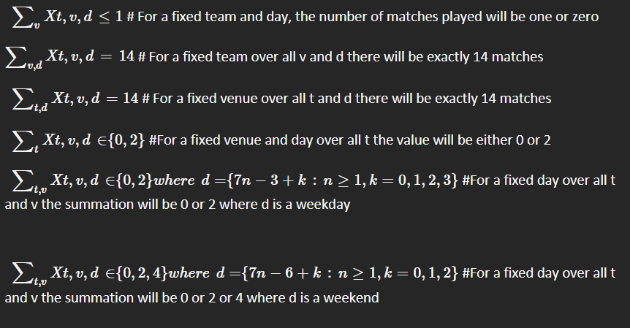
Notes:
On a single day a team will play 0 or 1 match
Each team will play total 14 matches in phase 2
14 matches will happen in each venue
On a particular day at a venue total teams playing will be 0 or 2
0/1 Match happening on week day
0/1/2 Match happening on week ends

Slide 9
Phase-2
we can take the stadium near the centre of all the venues for minimizing the worst case travel and hotel costs.
Mass of venue = -1*average hotel costs at that particular venue
Let (cix, ciy) represent the coordinates of the venues and mass Mi represent the mass of venue
The centre of mass = Σ Mi(Carrow)/Σ Mi
The venue closest to the point of centre of mass can be picked as the location of game where all the last 4 matches will be held

Slide 10
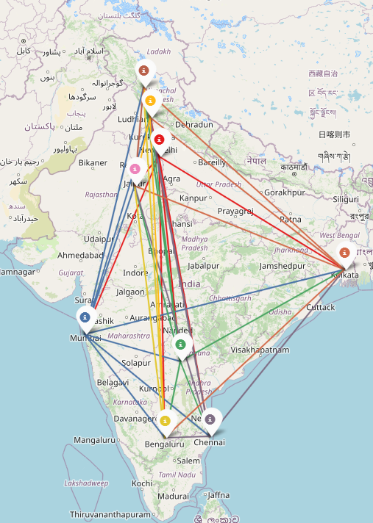

Slide 11
Required data for solving the formulation is hotel and flight costs
The cost of hotel will be sourced from online booking platform Booking.com
The cost of flights for all sources and partner airlines will be sourced from ixigo.com
Equidistant projection of the map of india for phase 2 location optimisation

Slide 12
THANKS!

